Slide 1
UNIT – V AIRCRAFT INSTRUMENTS

Slide 2
Flight Instruments
The instruments used in controlling the aircraft’s flight attitude are known as the flight instruments.
There are basic flight instruments, such as the altimeter that displays aircraft altitude; the airspeed indicator; and the magnetic direction indicator, a form of compass.
Additionally, an artificial horizon, turn coordinator, and vertical speed indicator are flight instruments present in most aircraft.
Original analog flight instruments are operated by air pressure and the use of gyroscopes.

Slide 3
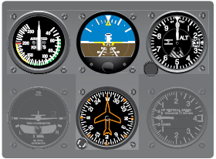

Slide 4
Engine Instruments
Engine instruments are those designed to measure operating parameters of the aircraft’s engine(s). These are usually quantity, pressure, and temperature indications.
They also include measuring engine speed(s). The most common engine instruments are the fuel and oil quantity and pressure gauges, tachometers, and temperature gauges.

Slide 5
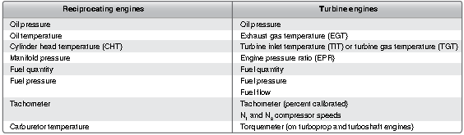

Slide 6
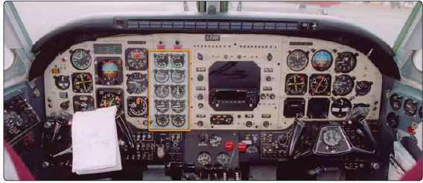

Slide 7
Navigation Instruments
Navigation instruments are those that contribute information used by the pilot to guide the aircraft along a definite course.
This group includes compasses of various kinds, some of which incorporate the use of radio signals to define a specific course while flying the aircraft en route from one airport to another.
Other navigational instruments are designed specifically to direct the pilot’s approach to landing at an airport.
Traditional navigation instruments include a clock and a magnetic compass. Along with the airspeed indicator and wind information, these can be used to calculate navigational progress.
Radios and instruments sending locating information via radio waves have replaced these manual efforts in modern aircraft.

Slide 8
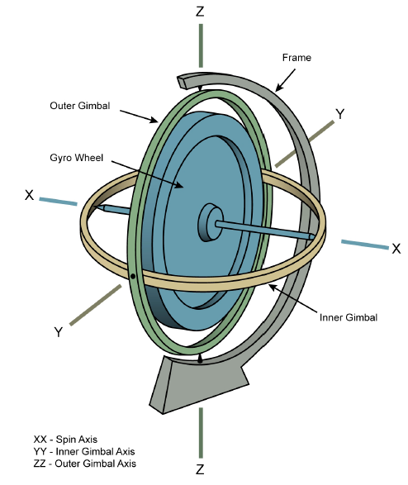
Gyroscope

Slide 9
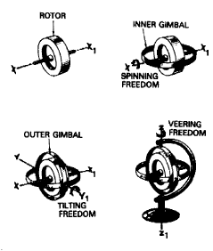
Elements of gyroscope

Slide 10
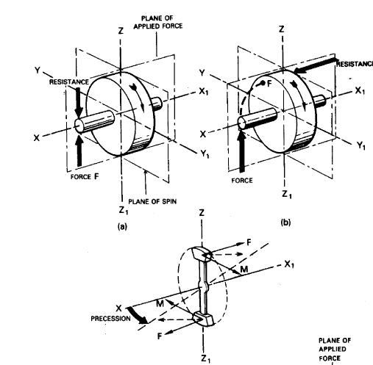
Determining the Direction of Precession

Slide 11
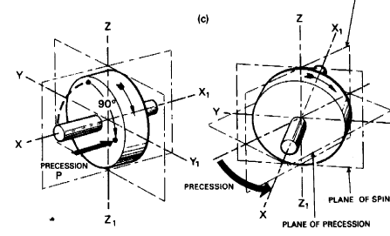

Slide 12
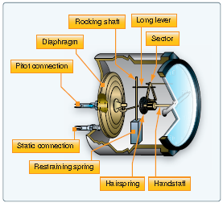
Airspeed indicator

Slide 13
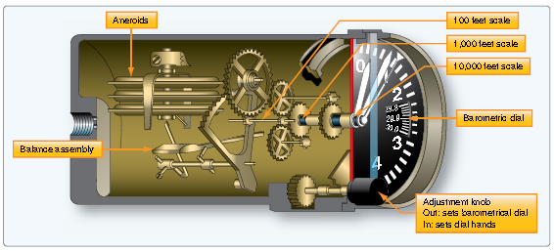
Altimeter

Slide 14
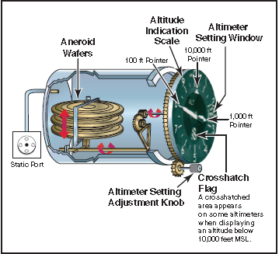

Slide 15
Pressure Measuring Instruments
A number of instruments inform the pilot of the aircraft’s condition and flight situations through the measurement of pressure.
They can be either direct reading or remote sensing.
These are some of the most critical instruments on the aircraft and must accurately inform the pilot to maintain safe operations.
The three fundamental pressure-sensing mechanisms used in aircraft instrument systems are the Bourdon tube, the diaphragm or bellows, and the solid-state sensing device.

Slide 16
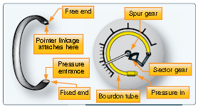
Bourdon tube pressure gauge

Slide 17
A Bourdon tube is illustrated in Figure 10-9.
The open end of this coiled tube is fixed in place and the other end is sealed and free to move. When a fluid that needs to be measured is directed into the open end of the tube, the unfixed portion of the coiled tube tends to straighten out.
The higher the pressure of the fluid, the more the tube straightens. When the pressure is reduced, the tube recoils.
A pointer is attached to this moving end of the tube, usually through a linkage of small shafts and gears. By calibrating this motion of the straightening tube, a face or dial of the instrument can be created.
Thus, by observing the pointer movement along the scale of the instrument face positioned behind it, pressure increases and decreases are communicated to the pilot.

Slide 18
The Bourdon tube is the internal mechanism for many pressure gauges used on aircraft. When high pressures need to be measured, the tube is designed to be stiff. Gauges used to indicate lower pressures use a more flexible tube that uncoils and coils more readily.
Most Bourdon tubes are made from brass, bronze, or copper.
Alloys of these metals can be made to coil and uncoil the tube consistently numerous times.
Bourdon tube gauges are simple and reliable. Some of the instruments that use a Bourdon tube mechanism include the engine oil pressure gauge, hydraulic pressure gauge, oxygen tank pressure gauge, and deice boot pressure gauge.
Since the pressure of the vapor produced by a heated liquid

Slide 19
Here, the Bourdon tube’s motion is converted to an electrical signal and carried to the cockpit display via a wire.
This is lighter and more efficient, eliminating the possibility of leaking fluids into the passenger compartment of the aircraft.

Slide 20
Diaphragm Pressure Gauge
The diaphragm and bellows are two other basic sensing mechanisms employed in aircraft instruments for pressure measurement.
The diaphragm is a hollow, thin-walled metal disk, usually corrugated. When pressure is introduced through an opening on one side of the disk, the entire disk expands.
By placing linkage in contact against the other side of the disk, the movement of the pressurized diaphragm can be transferred to a pointer that registers the movement against the scale on the instrument face.

Slide 21
Diaphragms can also be sealed. The diaphragm can be evacuated before sealing, retaining absolutely nothing inside.
When this is done, the diaphragm is called an aneroid.
Androids are used in many flight instruments.
A diaphragm can also be filled with a gas to standard atmospheric pressure
and then sealed.
The common factor in all is that the expansion and contraction of the side wall of the diaphragm is the movement that correlates to increasing and decreasing pressure.

Slide 22
Bellows type pressure gauge
When a number of diaphragm chambers are connected together, the device is called a bellows.
This accordion like assembly of diaphragms can be very useful when
measuring the difference in pressure between two gases, called differential pressure.
Just as with a single diaphragm, it is the movement of the side walls of the bellows assembly that correlates with changes in pressure and to which a
pointer linkage and gearing is attached to inform the pilot.

Slide 23
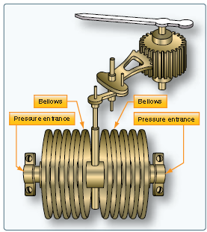

Slide 24
In this case, the sensing device containing the pressure sensitive diaphragm
or bellows is located remotely on the engine or airframe.
It is part of a transducer that converts the pressure into an electrical signal. The transducer, or transmitter, sends the signal to the gauge in the cockpit, or to a computer, for processing and subsequent display of the sensed condition.
Examples of instruments that use a diaphragm or bellows in a direct reading or remote sensing gauge are the altimeter, vertical speed indicator, cabin differential pressure gauge (in pressurized aircraft), and manifold pressure gauge.

Slide 25
Hydraulic Pressure
Numerous other pressure monitoring gauges are used on complex aircraft to indicate the condition of various support systems not found on simple light aircraft.
Hydraulic systems are commonly used to raise and lower landing gear, operate flight controls, apply brakes, and more.
Sufficient pressure in the hydraulic system developed by the hydraulic pump(s) is required for normal operation of hydraulic devices.

Slide 26
Hydraulic pressure gauges are often located in the cockpit and at or near the hydraulic system servicing point on the airframe.
Remotely located indicators used by maintenance personnel are almost always direct reading Bourdon tube type gauges.
Cockpit gauges usually have system pressure transmitted from sensors or computers electrically for indication.

Slide 27
Vacuum Pressure gauge
Gyro pressure gauge, vacuum gauge, or suction gauge are all terms for the same gauge used to monitor the vacuum developed in the system that actuates the air driven gyroscopic flight instruments.
Air is pulled through the instruments, causing the gyroscopes to spin.
The speed at which the gyros spin needs to be within a certain range for
correct operation.
This speed is directly related to the suction pressure that is developed in the system.

Slide 28
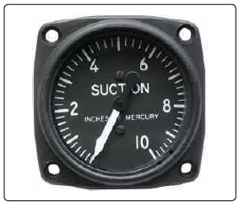

Slide 29
The suction gauge is extremely important in aircraft relying solely on vacuum operated gyroscopic flight instruments.
Vacuum is a differential pressure indication, meaning the pressure to be measured is compared to atmospheric pressure through the use of a sealed diaphragm or capsule.
The gauge is calibrated in inches of mercury.
It shows how much less pressure exists in the system than in the atmosphere.

Slide 30
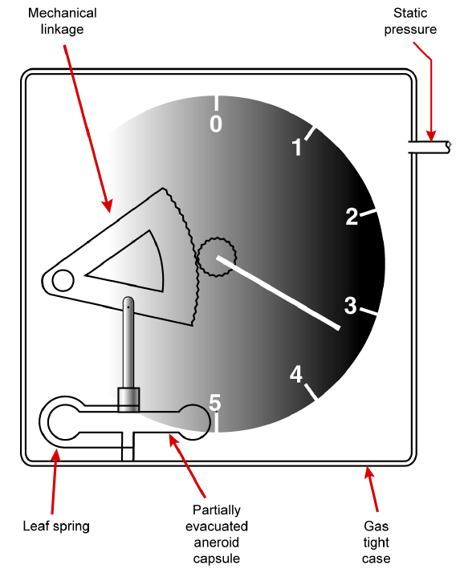

Slide 31
At sea level and standard atmospheric conditions, the linkage attached to the expandable diaphragm produces an indication of zero.
When altitude increases, static pressure on the outside of the diaphragm decreases and the aneroid expands, producing a positive indication of altitude.
When altitude decreases, atmospheric pressure increases.
The static air pressure on the outside of the diaphragm increases and the pointer moves in the opposite direction, indicating a decrease in altitude.

Slide 32
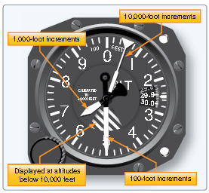

Slide 33
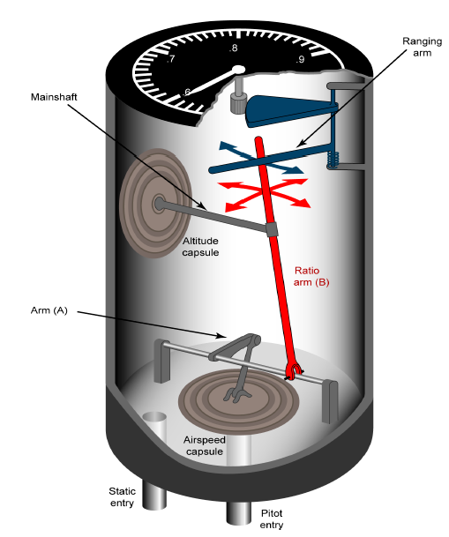
Mach meter

Slide 34
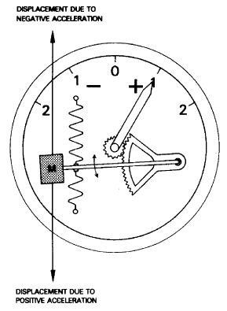
Basic accelerometer mechanism

Slide 35
Tachometers
The tachometer, or tach, is an instrument that indicates the speed of the crankshaft of a reciprocating engine.
It can be a direct- or remote-indicating instrument, the dial of which is calibrated to indicate revolutions per minutes (rpm).
On reciprocating engines, the tach is used to monitor engine power and to ensure the engine is operated within certified limits.
Gas turbine engines also have tachometers. They are used to monitor the speed(s) of the compressor section(s) of the engine.
Turbine engine tachometers are calibrated in percentage of rpm with 100 percent corresponding to optimum turbine speed.

Slide 36
Mechanical Tachometers
Mechanical tachometer indicating systems are found on small, single-engine light aircraft in which a short distance exists between the engine and the instrument panel.
They consist of an indicator connected to the engine by a flexible drive shaft.
The drive shaft is geared into the engine so that when the engine turns, so does the shaft. The indicator contains a flyweight assembly coupled to a gear mechanism that drives a pointer.

Slide 37
As the drive shaft rotates, centrifugal force acts on the flyweights and moves them to an angular position.
This angular position varies with the rpm of the engine.
The amount of movement of the flyweights is transmitted through the gear mechanism to the pointer.
The pointer rotates to indicate this movement on the tachometer indicator, which is directly related to the rpm of the engine.

Slide 38
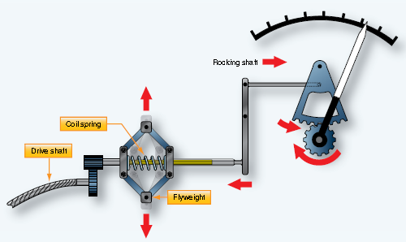

Slide 39
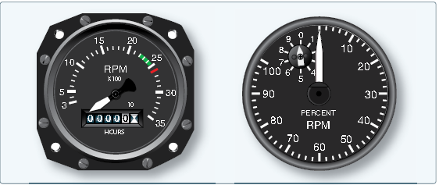

Slide 40
Electric Tachometers
It is not practical to use a mechanical linkage between the engine and the rpm indicator on aircraft with engines not mounted in the fuselage just forward of the instrument panel.
Greater accuracy with lower maintenance is achieved through the use of electric tachometers.

Slide 41
A popular electric tachometer system makes use of a small AC generator mounted to a reciprocating engine’s gear case or the accessory drive section of a turbine engine.
As the engine turns, so does the generator.
The frequency output of the generator is directly proportional to the speed of the engine.
It is connected via wires to a synchronous motor in the indicator that mirrors this output.
A drag cup, or drag disk link, is used to drive the indicator as in a mechanical tachometer.

Slide 42
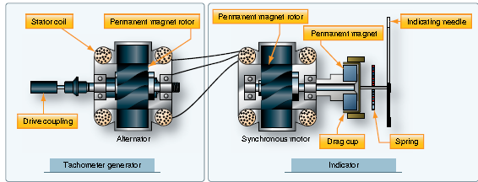

Slide 43
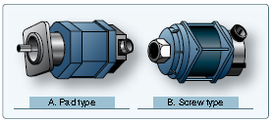

Slide 44
The dual tachometer consists of two tachometer indicator units housed in a single case.
The indicator pointers show simultaneously, on one or two scales, the rpm of two engines.
A dual tachometer on a helicopter often shows the rpm of the engine and the rpm of the main rotor.
A comparison of the voltages produced by the two tach generators of this type of helicopter indicator gives information concerning clutch
slippage.
A third indication showing this slippage is sometimes included in the helicopter tachometer.

Slide 45
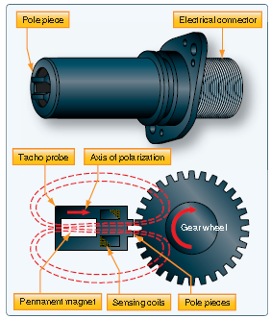

Slide 46
Some turbine engines use tachometer probes for rpm indication, rather than a tach generator system.
They provide a great advantage in that there are no moving parts.
They are sealed units that are mounted on a flange and protrude into
the compressor section of the engine.
A magnetic field is set up inside the probe that extends through pole pieces and out the end of the probe.
A rotating gear wheel, which moves at the same speed as the engine compressor shaft, alters the magnetic field flux density as it moves past the pole pieces at close proximity.

Slide 47
This generates voltage signals in coils inside the probe. The amplitude of the EMF signals vary directly with the speed of the engine.
The tachometer probe’s output signals need to be processed
in a remotely located module.
They must also be amplified to drive a servo motor type indicator in the cockpit.
They may also be used as input for an automatic power control system or a flight data acquisition system

Slide 48
Temperature Measuring Instruments
The temperature of numerous items must be known for an aircraft to be operated properly.
Engine oil, carburetor mixture, inlet air, free air, engine cylinder heads, heater ducts, and exhaust gas temperature of turbine engines are all items
requiring temperature monitoring.
Many other temperatures must also be known. Different types of thermometers are used to collect and present temperature information.

Slide 49
Electrical Resistance Thermometer
For most metals, electrical resistance changes as the temperature of the metal changes. This is the principle upon which a resistance thermometer operates.
The principle parts of the electrical resistance thermometer are the indicating instrument, the temperature-sensitive element (or bulb), and the connecting wires and plug connectors.
Electrical resistance thermometers are used widely in many types of aircraft to measure carburetor air, oil, free air temperatures, and more.
They are used to measure low and medium temperatures in the –70 °C to 150 °C range

Slide 50
Typically, the electrical resistance of a metal increases as the temperature
rises.
Various alloys have a high temperature-resistance coefficient, meaning their resistance varies significantly with temperature.
This can make them suitable for use in temperature sensing devices. The metal resistor is subjected to the fluid or area in which temperature needs to be measured.
It is connected by wires to a resistance measuring device inside the cockpit indicator. The instrument dial is calibrated in degrees Fahrenheit or Celsius as desired rather than in ohms.

Slide 51
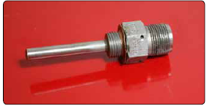

Slide 52
The temperature-sensitive resistor element is a length or winding made of a nickel/manganese wire or other suitable alloy in an insulating material.
The resistor is protected by a closed-end metal tube attached to a threaded plug with a hexagonal head.
The two ends of the winding are brazed, or welded, to an electrical receptacle designed to receive the prongs of the connector plug.

Slide 53
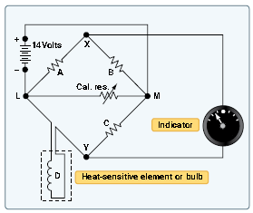

Slide 54
The indicator contains a resistance-measuring instrument. Sometimes it uses a modified form of the Wheatstone bridge circuit.
The Wheatstone-bridge meter operates on the principle of balancing one unknown resistor against other known resistances.
A simplified form of a Wheatstone bridge circuit is shown in Figure . Three equal values of resistance are connected into a diamond shaped bridge circuit.
A resistor with an unknown value is also part of the circuit.
The unknown resistance represents the resistance of the temperature bulb of the electrical resistance thermometer system.
A galvanometer is attached across the circuit at points X and Y.

Slide 55
When the temperature causes the resistance of the bulb to equal that of the other resistances, no potential difference exists between points X and Y in the circuit.
Therefore, no current flows in the galvanometer leg of the circuit.
If the temperature of the bulb changes, its resistance also changes, and the bridge becomes unbalanced, causing current to flow through the galvanometer in one direction or the other.
The galvanometer pointer is actually the temperature gauge pointer.
As it moves against the dial face calibrated in degrees, it indicates temperature. Many indicators are provided with a zero adjustment screw on the face of the instrument.
This adjusts the zeroing spring tension of the pointer when the bridge is at the balance point (the position at which the bridge circuit is balanced and no current flows through the meter).

Slide 56
Thermocouple Temperature Indicators
A thermocouple is a circuit or connection of two unlike metals. The metals are touching at two separate junctions.
If one of the junctions is heated to a higher temperature than the other, an electromotive force is produced in the circuit.
This voltage is directly proportional to the temperature. So, by measuring the amount of electromotive force, temperature can be determined. A voltmeter is placed across the colder of the two junctions of the thermocouple.
It is calibrated in degrees Fahrenheit or Celsius, as needed.

Slide 57
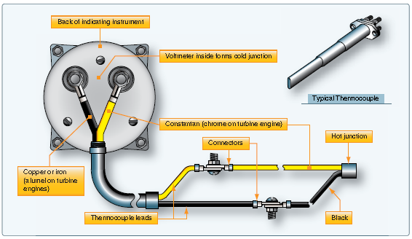

Slide 58
Thermocouples are used to measure high temperatures. Two common applications are the measurement of cylinder head temperature (CHT) in reciprocating engines and exhaust gas temperature (EGT) in turbine engines.
Thermocouple leads are made from a variety of metals, depending on the maximum temperature to which they are exposed.
Iron and constantan, or copper and constantan, are common for CHT measurement. Chromel and alumel are used for turbine EGT thermocouples.

Slide 59
The amount of voltage produced by the dissimilar metals when heated is measured in millivolts.
Therefore, thermocouple leads are designed to provide a specific amount of resistance in the thermocouple circuit (usually very little).
Their material, length, or cross-sectional size cannot be altered without compensation for the change in total resistance that would result.
Each lead that makes a connection back to the voltmeter must be made of the same metal as the part of the thermocouple to which it is connected.
For example, a copper wire is connected to the copper portion of the hot junction and a constantan wire is connected to the constantan part.

Slide 60
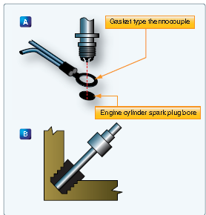

Slide 61
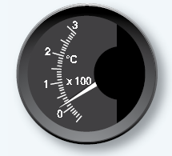
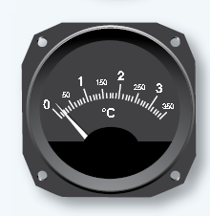

Slide 62
Turbine Gas Temperature Indicating Systems
EGT is a critical variable of turbine engine operation. The EGT indicating system provides a visual temperature indication in the cockpit of the turbine exhaust gases as they leave the turbine unit.
In certain turbine engines, the temperature of the exhaust gases is measured at the entrance to the turbine unit.
This is referred to as a turbine inlet temperature (TIT) indicating system.
Several thermocouples are used to measure EGT or TIT.
They are spaced at intervals around the perimeter of the engine turbine casing or exhaust duct.

Slide 63
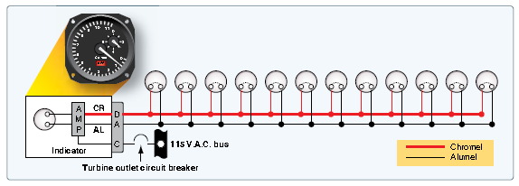

Slide 64
The tiny thermocouple voltages are typically amplified and used to energize a servomotor that drives the indicator pointer.
Gearing a digital drum indication off of the pointer motion is common
The EGT indicator shown is a hermetically sealed unit.
The instrument’s scale ranges from 0 °C to 1,200 °C, with a vernier dial in the upper right-hand corner and a power off warning flag located in the lower portion of the dial.

